Slide 1
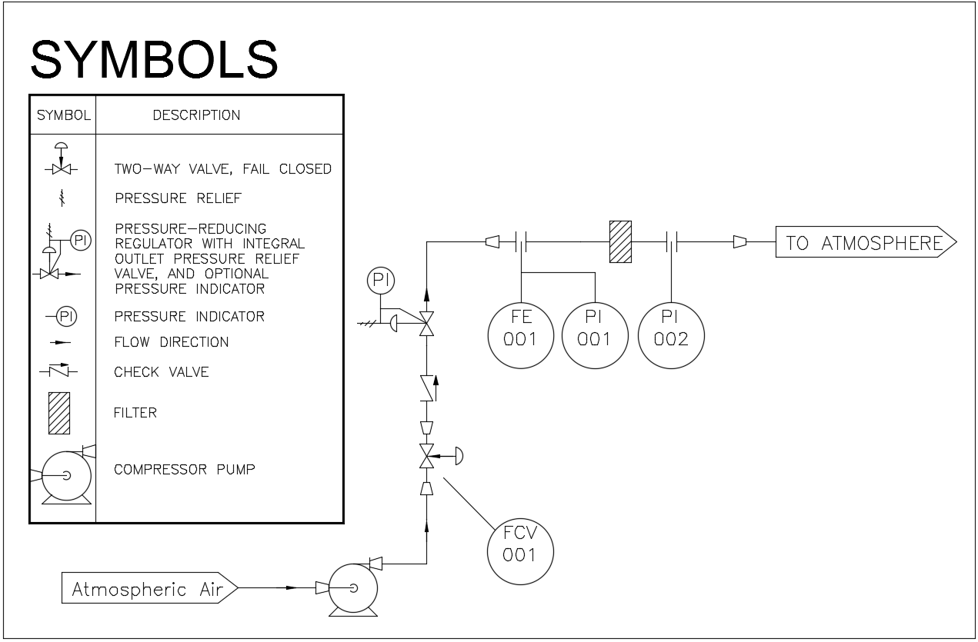
Proposed Design - P&ID
adapters
filter

Slide 2
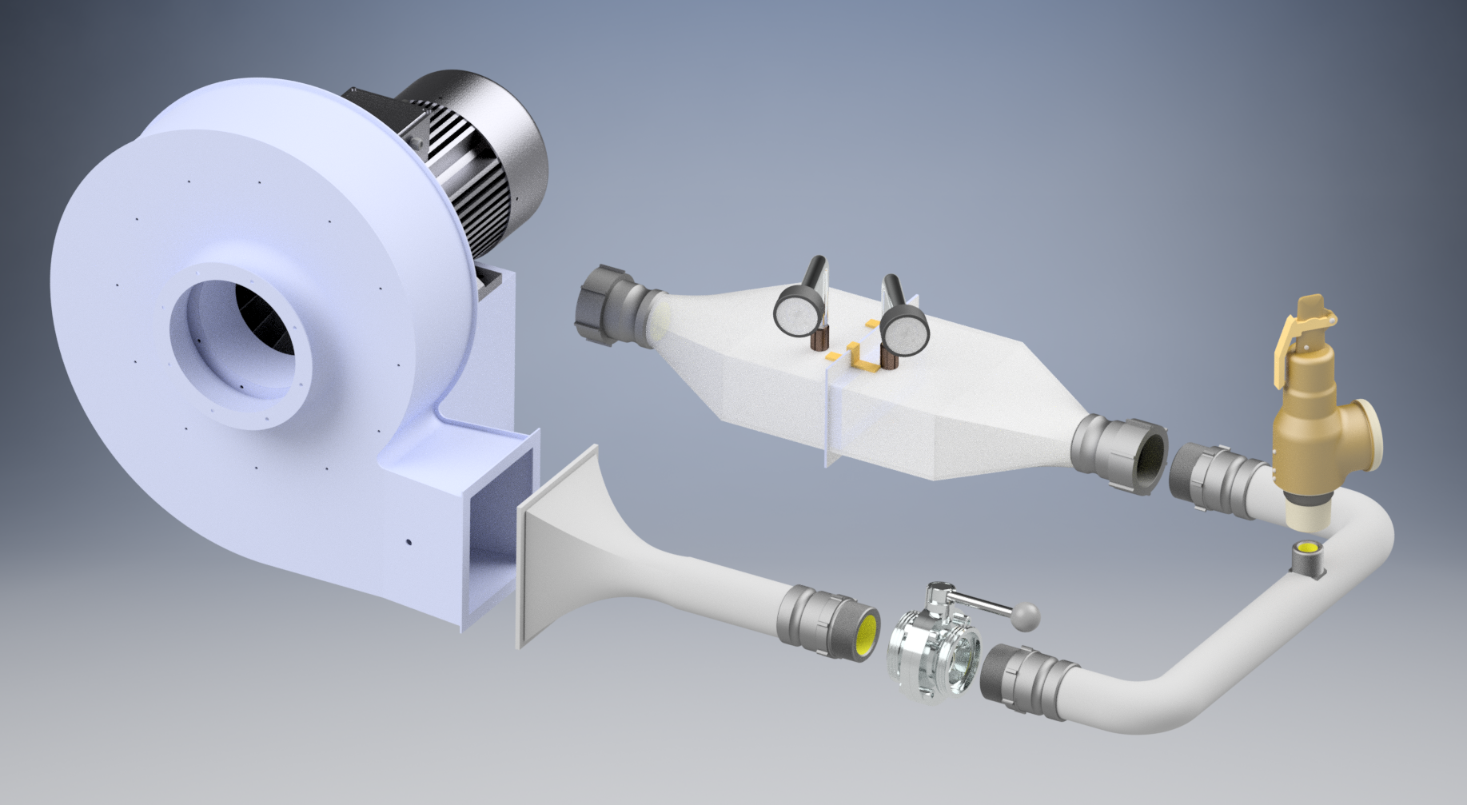
Proposed Design - CAD
Pressure Gauge
Safety
Relief Valve
2 inches pipe
Butterfly Valve

Slide 3
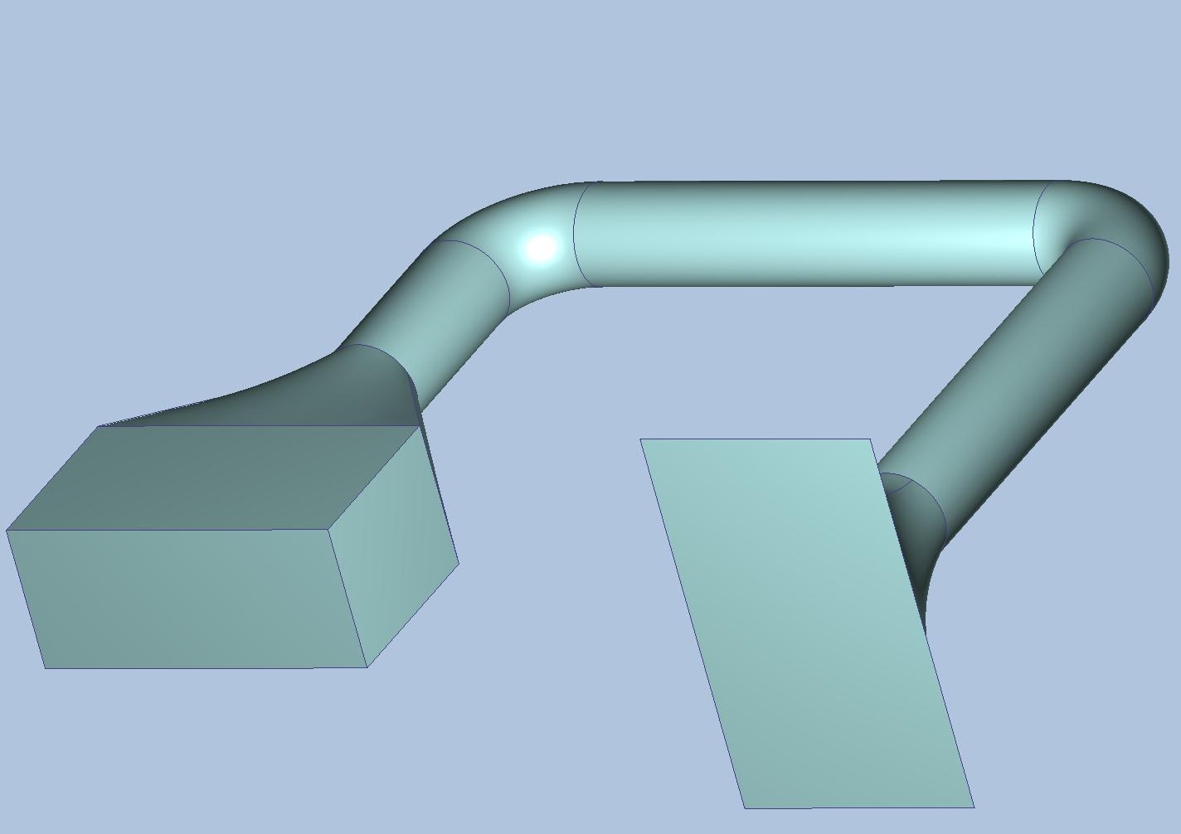
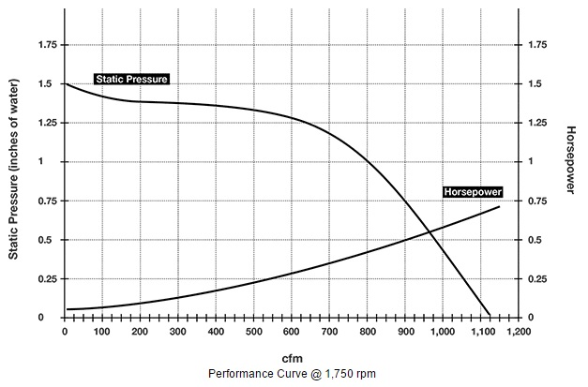
Proposed Design CFD analysis - LCD Cooling filter
Outlet of the compressor. Boundary condition set based on the performance curve.
Outlet of the simulation model, where the filter upstream pressure will be measured.

Slide 4
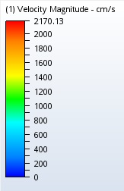
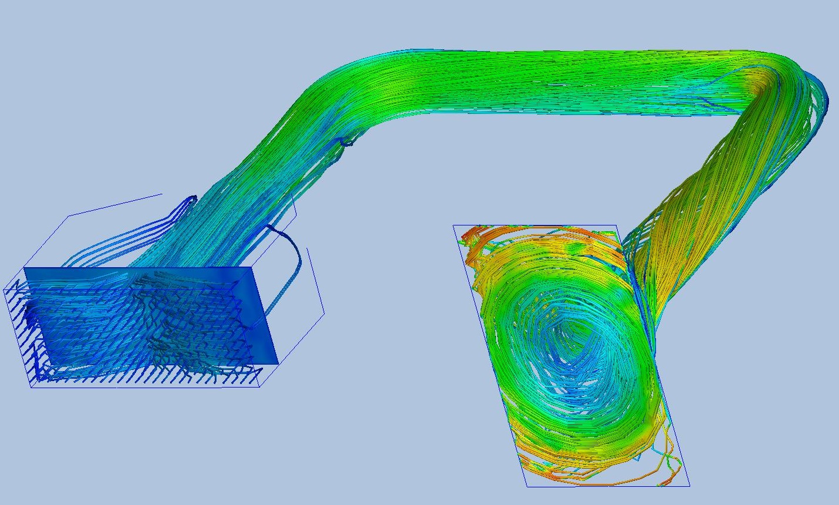
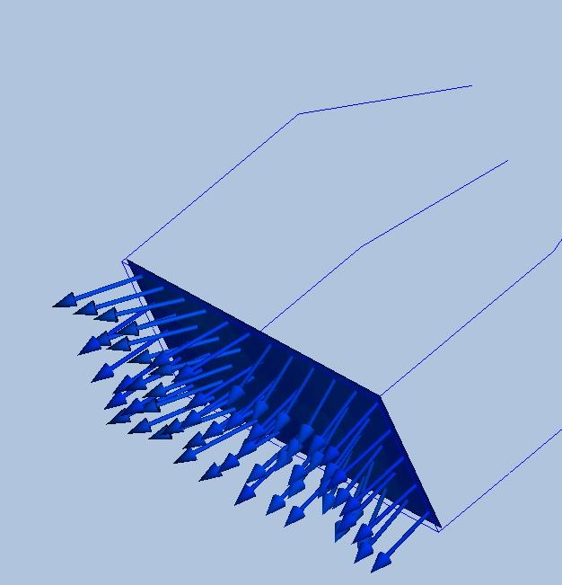
Proposed Design CFD analysis - Results
Velocity vectors
Particle-traces diagram

Slide 5
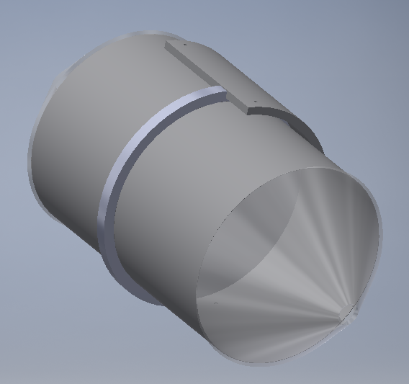
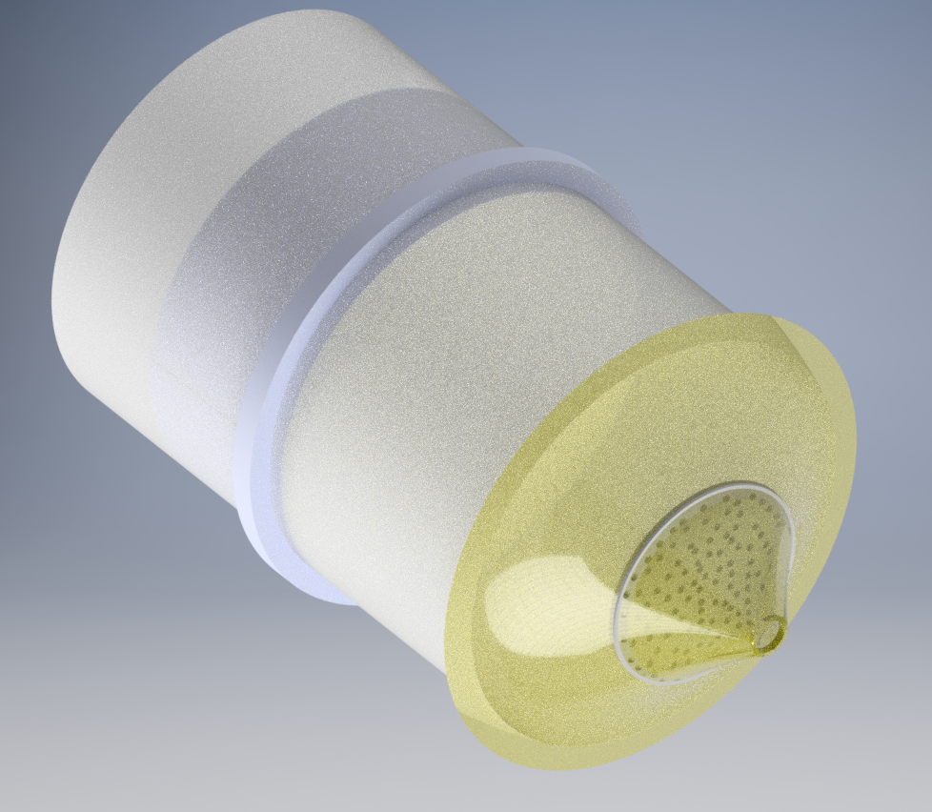
Proposed Design CFD analysis - Safety Valve Filter
mesh
Pressurization Control Aft Safety Valve Filter
Possible solution

